Slide 1
Notes:
{background slide to display prior to talk}

Slide 2
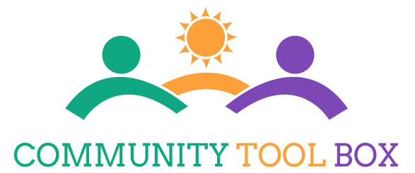
The Community Tool Box: Tools to Change our World
Core Values and Assumptions
Christina Holt
Notes:
Good afternoon. It is a pleasure to join you today, and to share with you some online, open-source resources for building capacity to support citizen engagement.

Slide 3
Notes:
Several core values and assumptions guide our work. First, justice requires conditions for human development. This takes collaborative action for working together across sectors to address development challenges. There is a need for competence in a diverse and distributed workforce – people taking action in countries and communities worldwide. Although there are numerous calls for taking action, capacity is often limited.

Slide 4
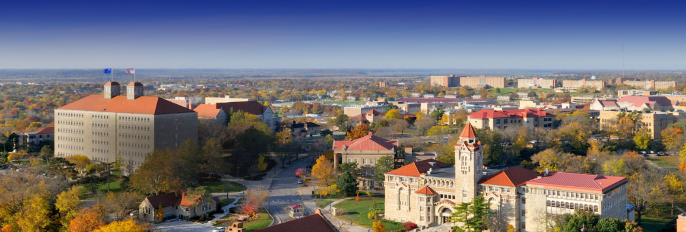
Mission of the KU Center for Community Health and Development
Supporting community health and development through…
participatory research and evaluation
teaching and training
technical support and capacity building
Notes:
The mission of our non-profit Center at the University is supporting community health and development through participatory research and evaluation, teaching and training, and technical support and capacity building.
Since 2004, our Center has been designated as a World Health Organization Collaborating Centre for Community Health and Development, with two primary objectives: 1st) Expand the evidence base for collaborative action to promote health and health equity, and 2) Build capacity among those doing the work locally, nationally, and globally.

Slide 5
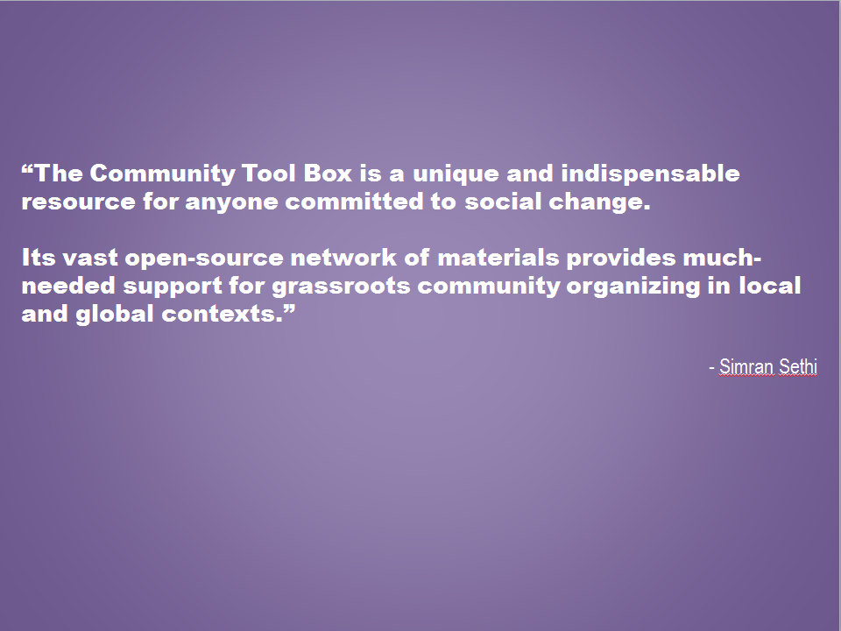
Closing dialogue
How can community psychology best support innovation and effective community change efforts?
How might SCRA foster innovation and community change?
How might online technology be used to foster innovation & help advance community change efforts?
Notes:
Quote from Simran Sethi

Slide 6
Our Vision: People – locally and globally– taking action
together to change conditions that affect their lives
Notes:
People can change the world. Our vision is of people – locally and globally – taking action together to change conditions that affect their lives.
The purpose of the Community Tool Box is to build capacity for this work—to make it easier for people to bring about change and improvement in their communities. The Community Tool Box connects people with resources for learning the many skills required for this work and applying this knowledge in diverse cultures and contexts.

Slide 7
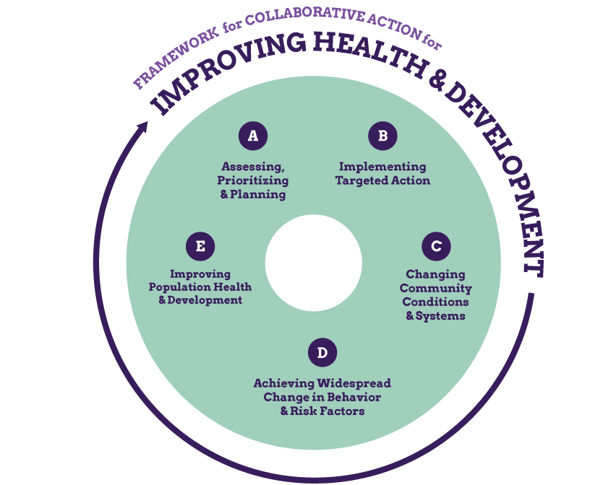
Notes:
What does this work look like? We utilize a framework for collaborative action published by the Institute of Medicine, which includes assessing community-determined needs, prioritizing and planning interventions, implementing targeted action, changing community conditions and systems, achieving widespread change in behavior and risk/protective factors, and ultimately leading to improving population health, development, and equity.

Slide 8
Some Challenges for Doing Community Work
Learning key skills
Solving problems
Guidance—what to do and when
Gaining access to what you need
When you need it
At an affordable cost
Notes:
8

Slide 9
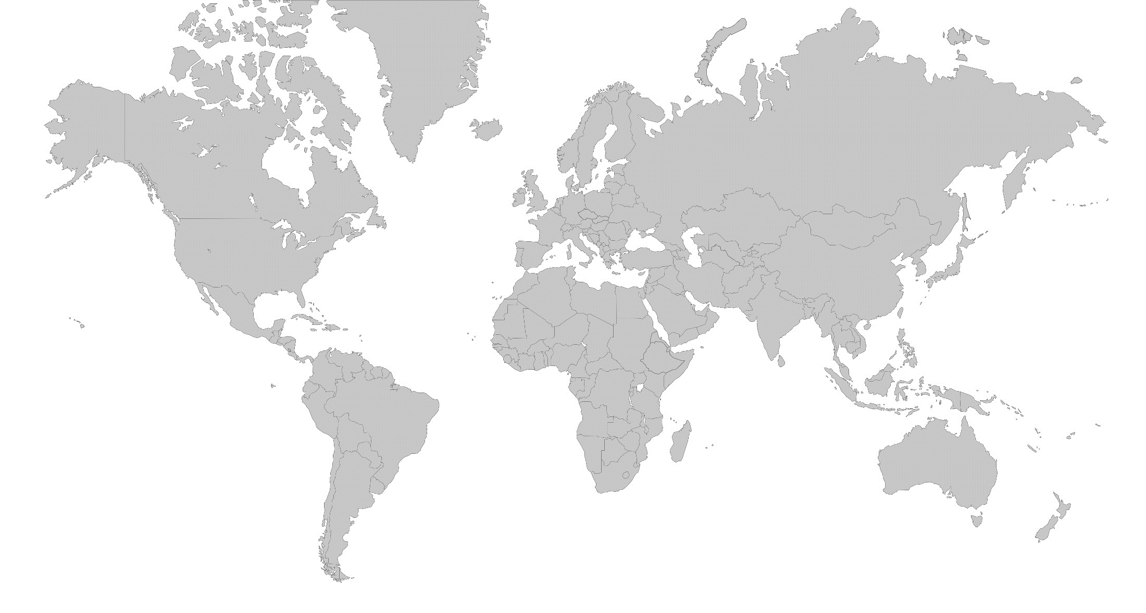
Context for Building Capacity for this Work
Conditions for equity and well-being not widespread
Takes—Collaborative action, across sectors
Need—Competence, in a diverse/ distributed workforce
Few can access training, technical support
Need—Practical, just-in-time supports for taking action
Notes:
Several assumptions undergird our efforts to build capacity for this work. First, conditions for population health and human development are unfortunately not yet widespread. This will take collaborative action, across sectors, and this will necessitate competence among those taking action in being able to work together. Also, accessing training and technical support can be difficult and cost-prohibitive, thus the need for practical, just-in-time supports for taking action.

Slide 10
https://www.youtube.com/watch?v=l1X6eljD7GE
Notes:
This brief video helps introduce the Community Tool Box.

Slide 11
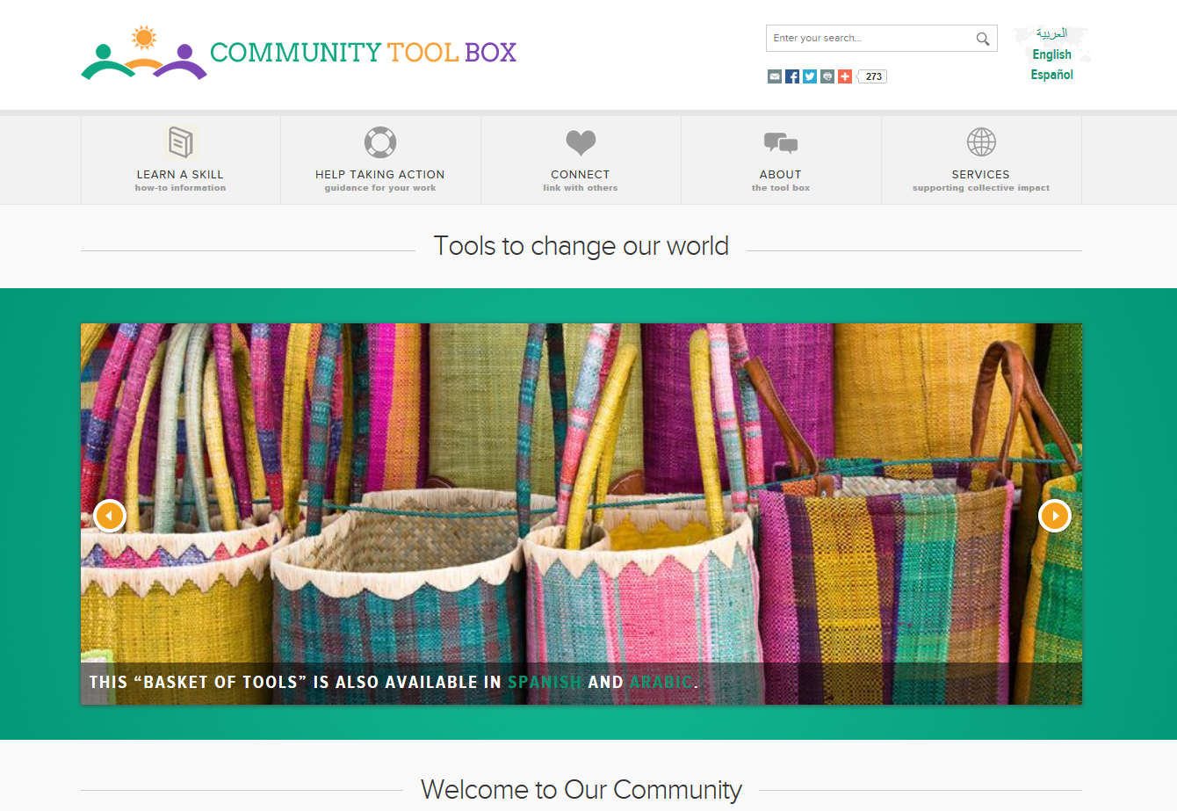
Notes:
Over the past 20 years, our group has engaged in making available to communities practical, how-to guidance for core competencies and skills needed for change and improvement. The Community Tool Box now offers over 7,000 pages of free, open source guidance for taking action for community health and development.
Core functions and related CTB features
Table of Contents: more than 300 sections including main content, examples, tools & checklists, and PowerPoints
Toolkits: Task analyses and related supports for 16 core competencies in community work
Links to databases of evidence-based practices and best processes for community change and improvement
11

Slide 12
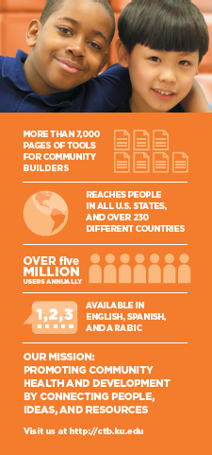
Tools for Building Capacity
How-to Guidance
Toolkits
Troubleshooting
Evidence-Based Practices
Notes:
The Community Tool Box provides “How-to Guidance” and practical tools for hundreds of topics.
Users can access these open-source resources to: a) Learn a Skill by viewing the Table of Contents for detailed guidance in community-building skills. Or, can visit the Toolkits for a quick start on applying core competencies in community work. Users can access Help for Taking Action through the Troubleshooting Guide to see common problems faced by those doing the work, and supports for addressing them. Or, users can access Databases of Evidence-Based Practices for community health and development.

Slide 13
Open source guidance for hundreds of community building topics, including:
Assessing community needs and resources
Building leadership
Increasing membership and participation
Writing a grant application
Advocacy
Interacting with elected officials
Evaluating initiatives
Fostering collaborative efforts
Sustaining your project
Notes:
The Community Tool Box offers guidance for hundreds of topics, including information on how to assess community needs and resources, build leadership, increase participation in community efforts, engage in advocacy efforts and policy development, evaluation, and planning for sustainability.
13

Slide 14
Audiences— Who uses the Community Tool Box?
Community members
Teachers and trainers
TA providers, evaluators
NGOs, private sector
Funders
Local, national, and international agencies
Notes:
Audiences that use the Community Tool Box are diverse, and include: community members, teachers and trainers, TA providers and evaluators, NGOs, the private sector, funders, and local, national, and international agencies.

Slide 15
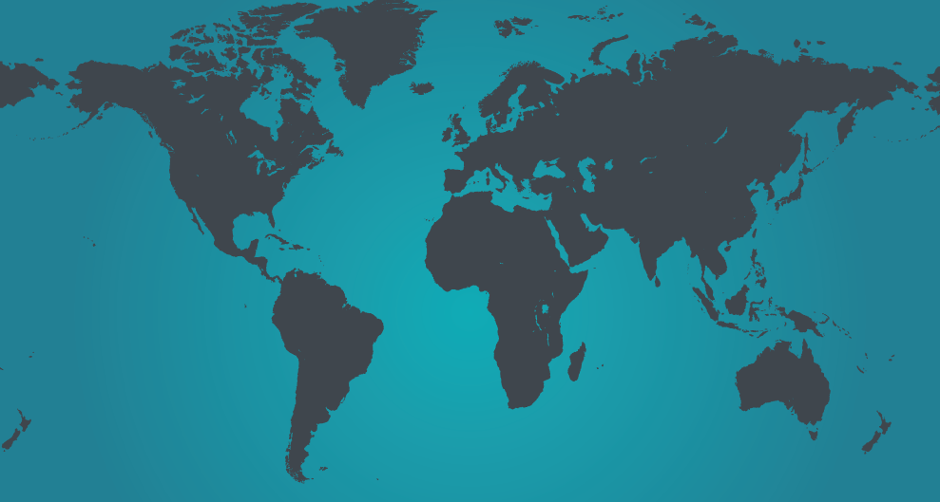
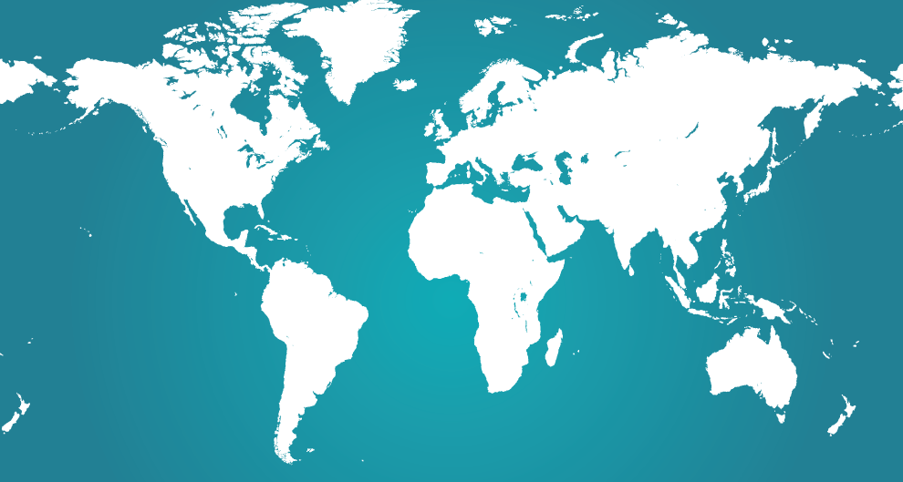
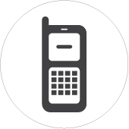
Growing Global Reach
6 million+ unique users
from 230 countries
Notes:
The CTB is a growing global resource; last year, there were over 5.8 million unique users from 230 countries.

Slide 16
CTB Use by Facilitators and Trainers:
“The site is an incredible source of resource materials. In the next two weeks I will be the lead facilitator in a training course for senior managers in the water and health sector. They will come from five to six different countries. I intend to use relevant sections to supplement what we have used in the past. I will also let them know about the site. Thanks and keep up the good work.”
- Vincent Njuguna, Nairobi, Kenya
Notes:
Users from all over the world tell us how they are using the Tool Box as a resource for their community change efforts. Here are a few quotes from the Guestbook about groups that are using free Community Tool Box resources in their training and technical assistance.

Slide 17
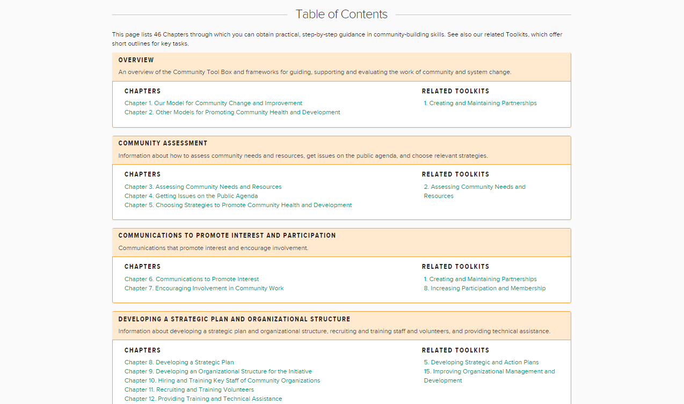
Notes:
The Table of Contents within the Community Tool Box provides an encyclopedia of sorts, walking users through practical, step-by-step guidance in community building skills. Containing more than 46 chapters and 340 sections, the Community Tool Box covers the span of community-building work, from community assessment, to promoting participation, to sustaining efforts over time.

Slide 18
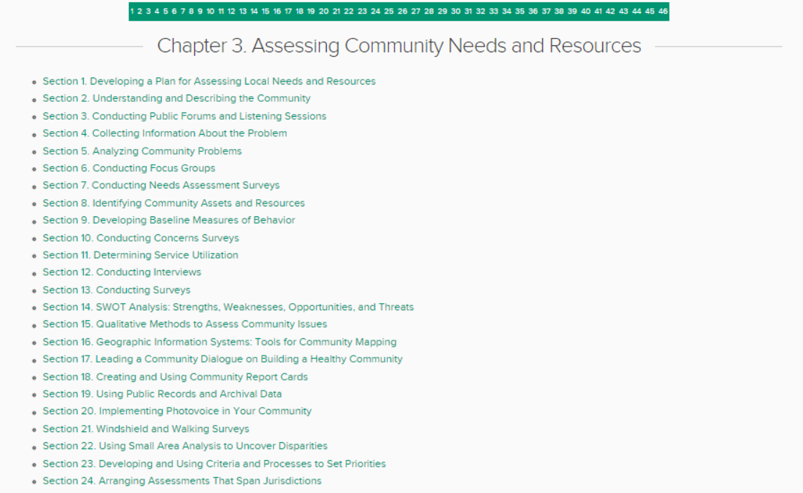
Notes:
For example, if you click into Chapter 3 from the Community Tool Box on Community Assessment, you will see sections providing how-to guidance for skills related to assessment such as conducting listening sessions, collecting information about the problem, conducting focus groups, conducting concerns surveys and SWOT Analyses, using GIS, PhotoVoice, Small Area Analysis, and other methods.

Slide 19
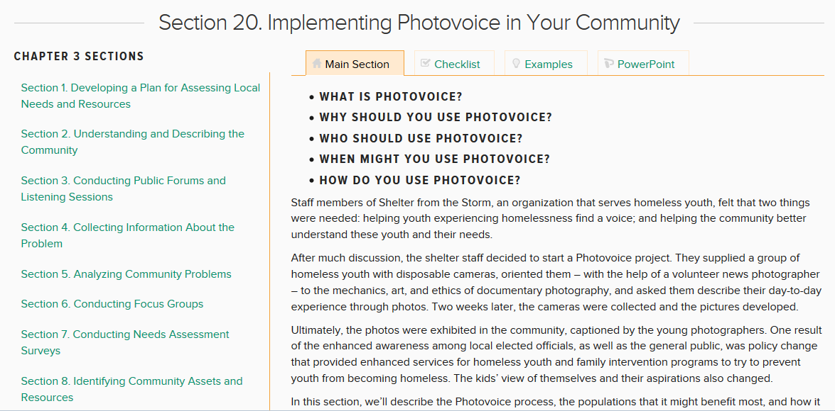

Slide 20
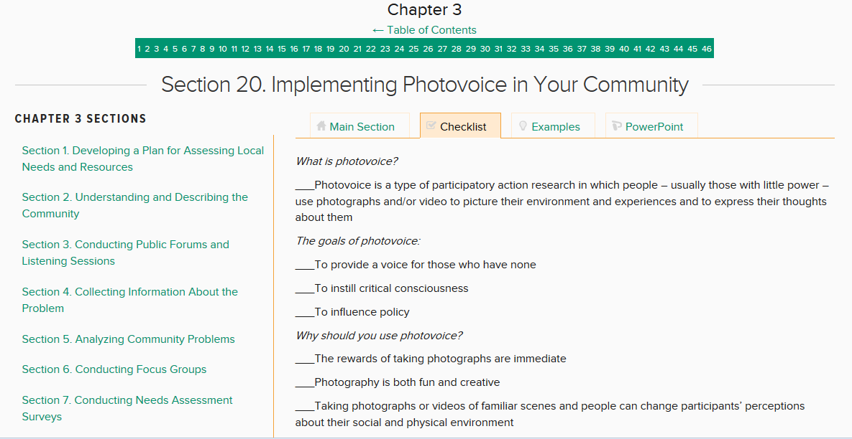

Slide 21
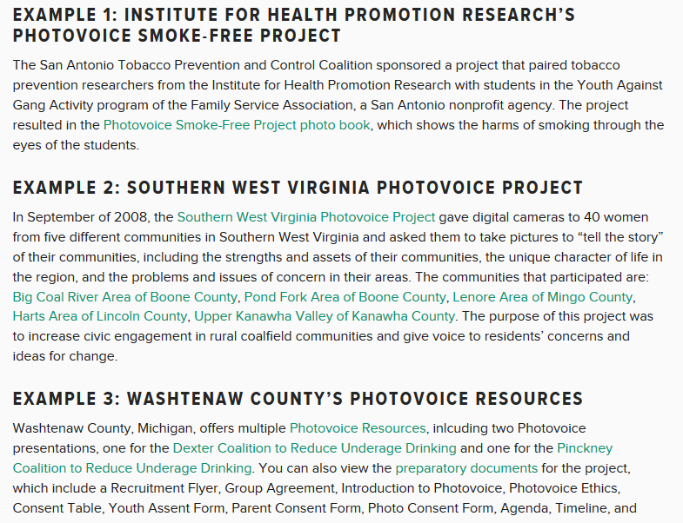

Slide 23
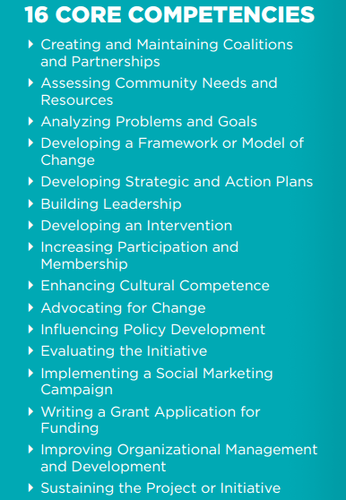
Open source tools for learning how to take action
Notes:
The heart of the Tool Box is open source tools for learning how to take action. The focus is on sixteen core competencies for how to do the work. For instance…
23

Slide 24
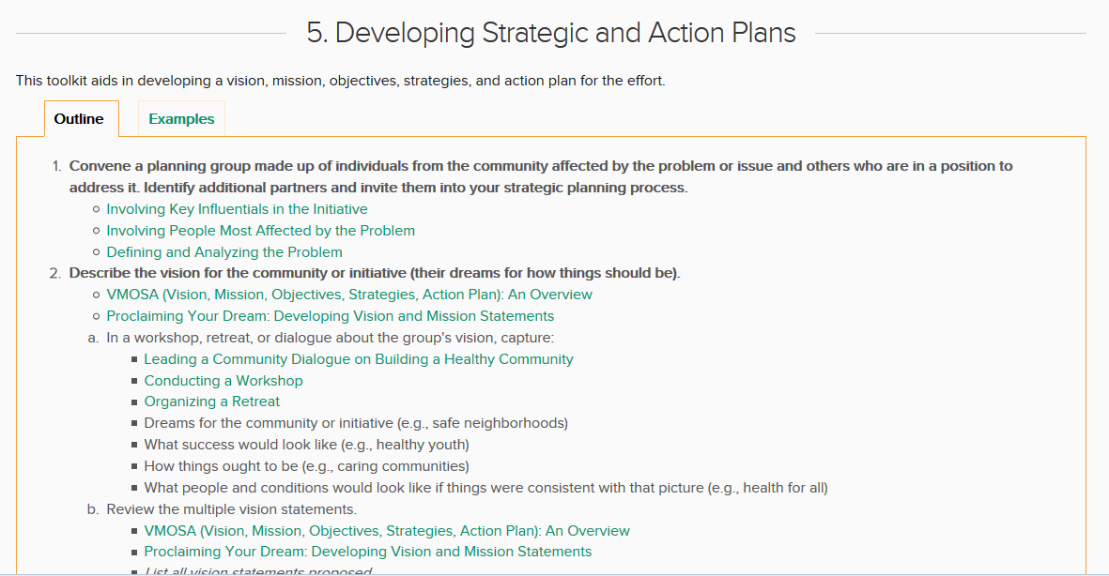
Notes:
For instance, this illustrative toolkit from the CTB is for “developing strategic and action plans.” It provides an outline for key activities or tasks , and links to how-to information to support implementation. For instance, …
Also, by clicking on the ‘Examples” tab (top right), the user can find examples of strategic plans developed for different issues, at different levels, in different contexts. The aim of the examples is to promote generalization of these tasks to the variety of places and situations in which people do their work.

Slide 25
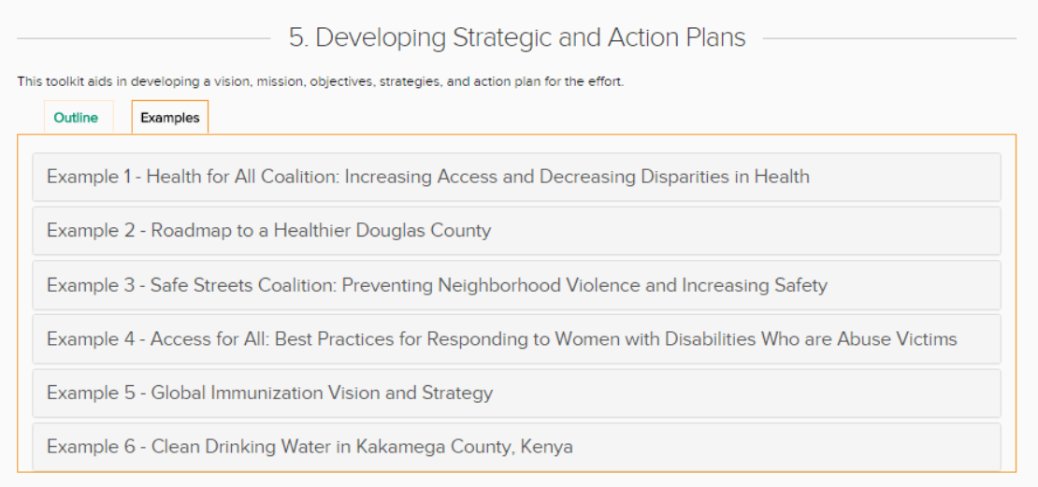
Notes:
Every toolkit has real-world examples that help users see how the competency has been implemented in different contexts, on different issues, and at different levels. For example, this toolkit features examples of the process of strategic and action plans from communities from Kansas to Kenya; and on different issues such as decreasing disparities, preventing violence, global immunization strategy, and developing a plan for assuring clean drinking water.

Slide 26
Notes:
Another way the resources are organized are through a Troubleshooting Guide that helps to structure technical support. Sometimes users seek guidance because they have run into a barrier or dilemma in their work. Using the Troubleshooting Guide, users can see common problems faced by those doing this work, and supports for addressing them. The Troubleshooting Guides are particularly helpful to those providing technical assistance.

Slide 27
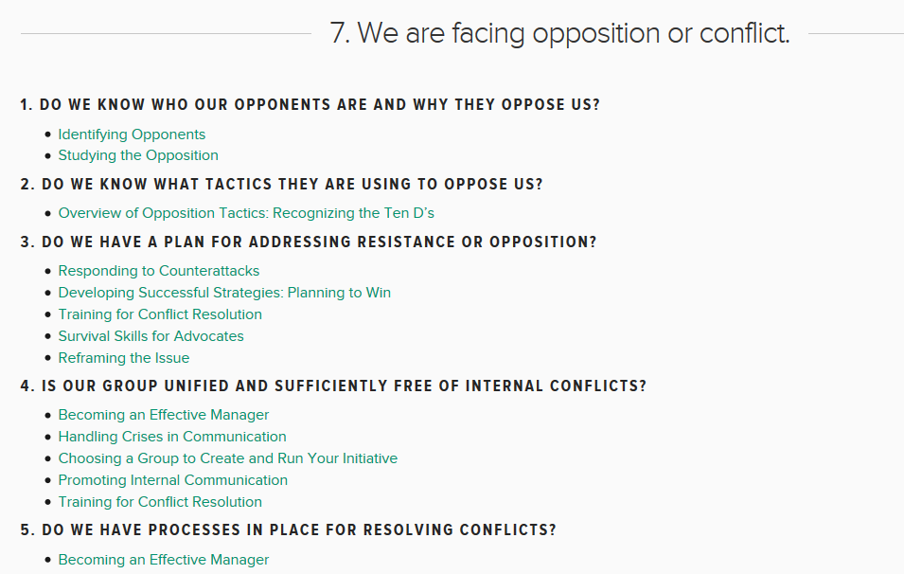
Notes:
For instance, this troubleshooting guide offers a situational assessment with reflection questions and links to supports for considering how to best face opposition or conflict. These questions then help users reach into more detailed how-to guidance for any area in which they feel they could use additional support.
These toolkits and troubleshooting guides are illustrations of open source content freely available in the CTB. These can be curated, or selected for, and then “mashed up” with other tools from other sources and partners.

Slide 28
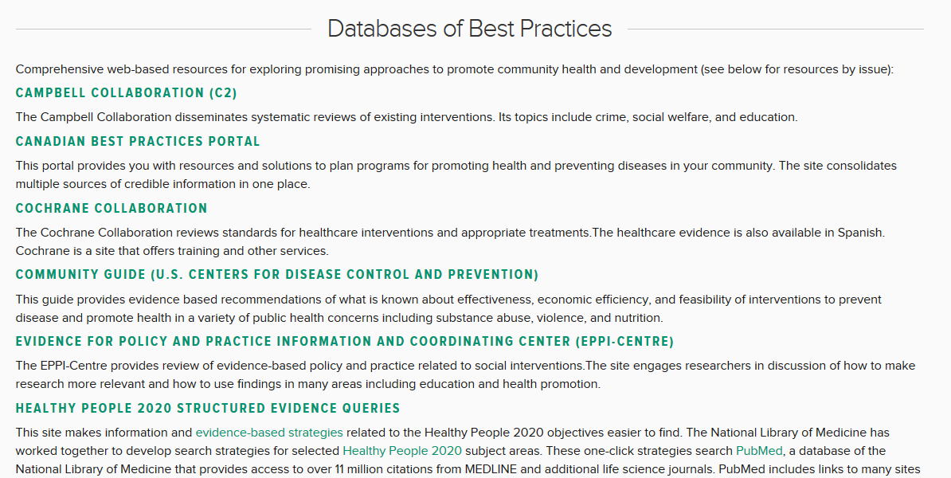

Slide 29
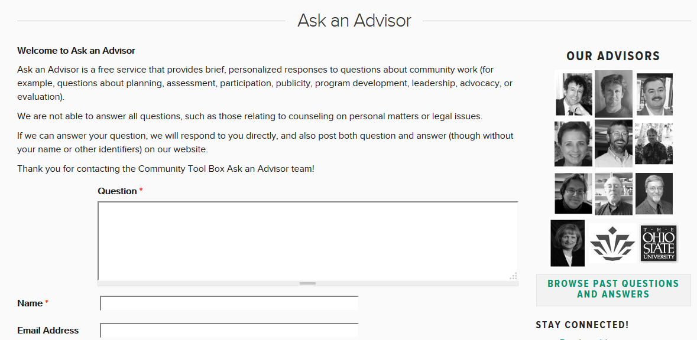
Notes:
And this shows the free Ask an Advisor service available through the CTB; where people can submit questions to seek guidance from experienced people and experts about issues relevant to their work, and can browse past questions and answers to learn from the experiences of others.

Slide 30
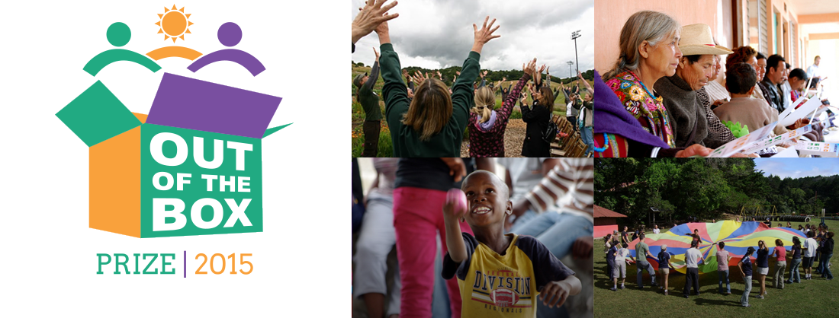
Notes:
The Tool Box offers a unique opportunity to lift up stories of community innovation from around the nation and around the world.

Slide 31
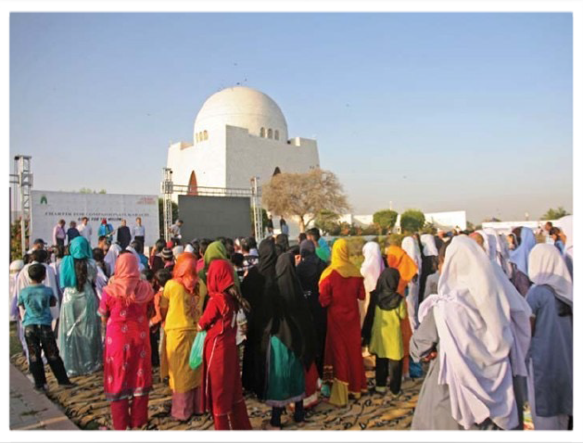
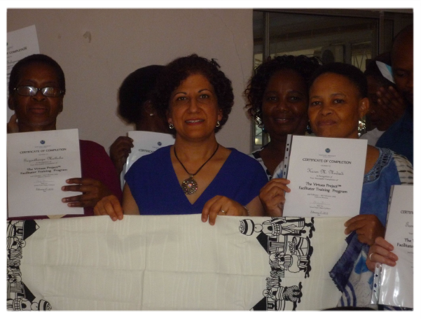
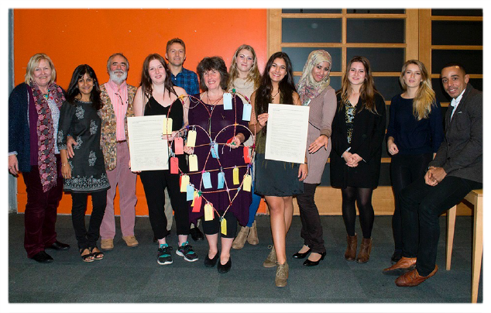
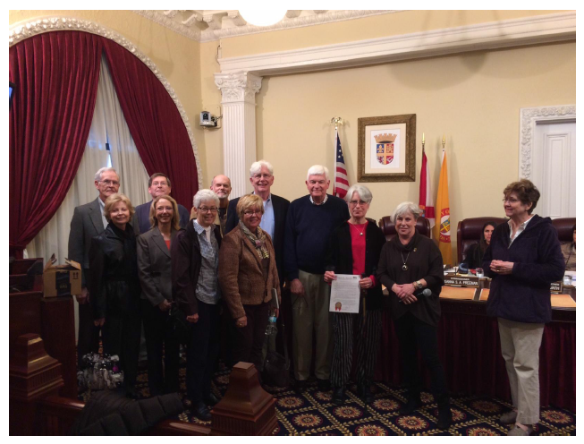
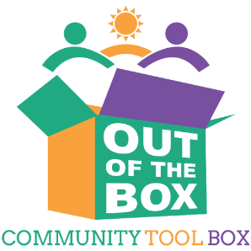
Story of Community Innovation:
Charter Tool Box
Notes:
The competition made it possible for people around the world to share what works and to inspire others to take action. We received stories from 342 applicants around the US and around the world. For example, community members working in a Kenyan resettlement village to increase access to clean drinking water after post-election violence, and people working to enhance access to healthy, affordable food through produce gleaning and rooftop gardens in Washington, DC.
The Tool Box offers a unique opportunity to lift up stories of community innovation from around the nation and around the world.

Slide 32
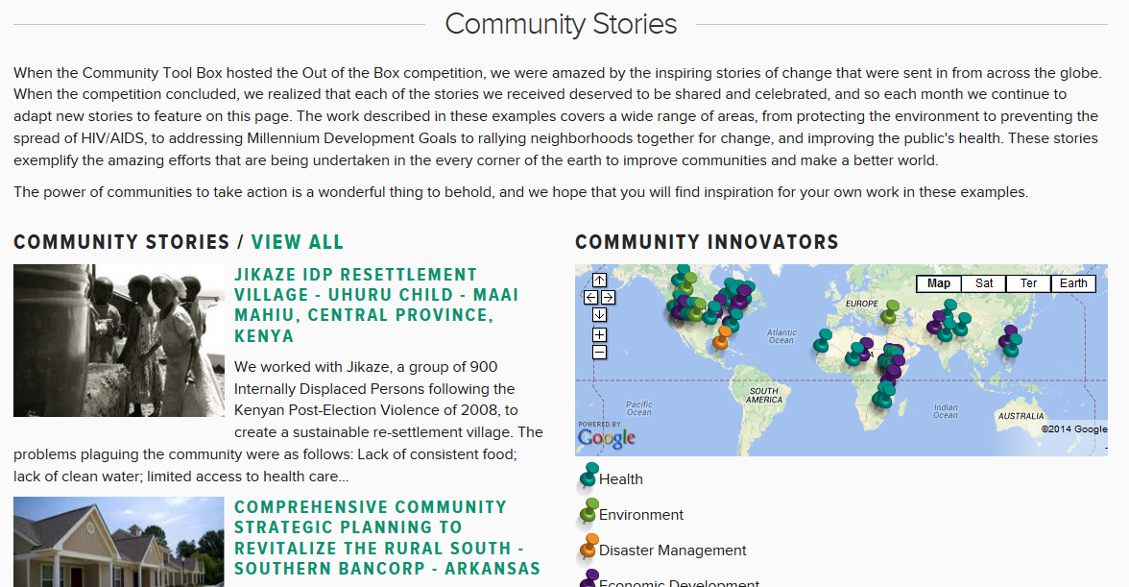

Slide 33
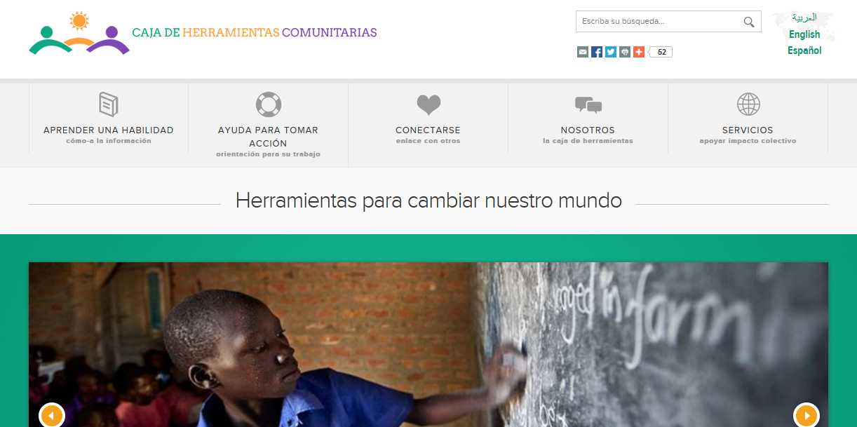
Notes:
Language translation and cultural adaptation has been an ongoing goal for further development of the Community Tool Box. To help assure access, the thousands of pages of the Community Tool Box have been translated and culturally adapted for Spanish, and also partially for Arabic. Additionally, being translated into French, Mandarin, Russian, and Portuguese.
We are always looking for partners for translation and cultural adaptation to make these open source resources available to people we will never meet, in places we will never be.

Slide 34
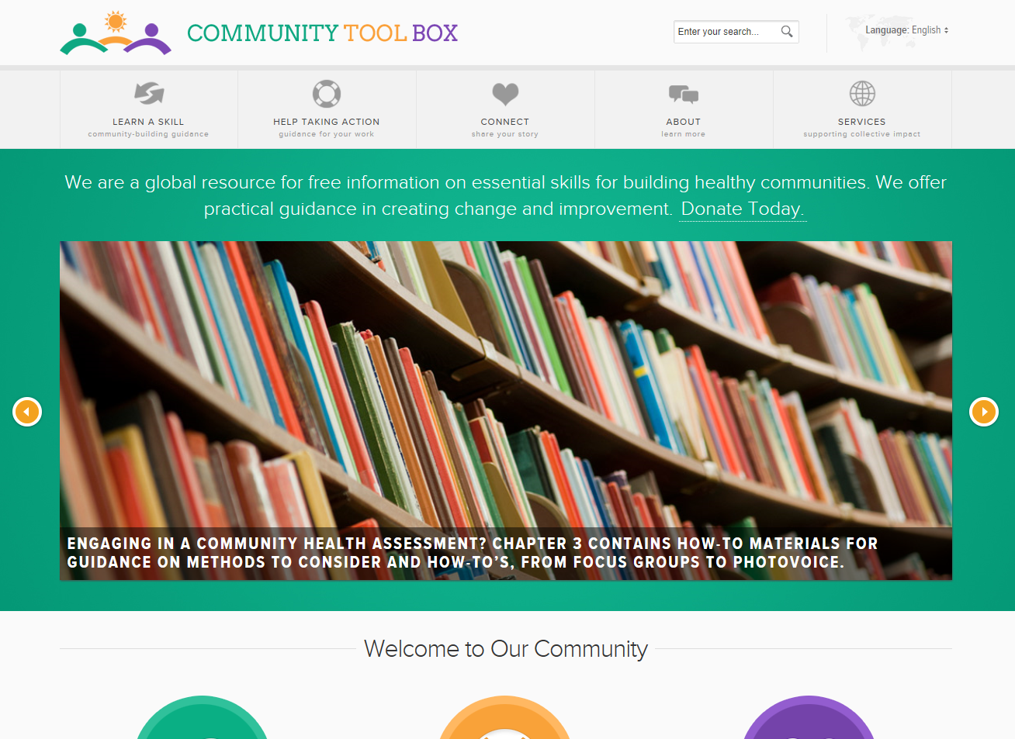
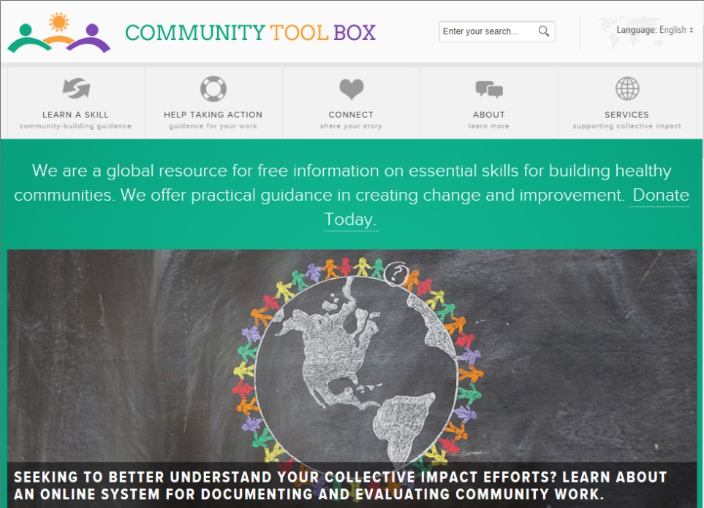
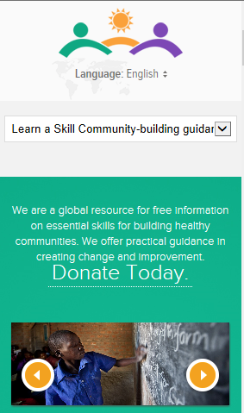
Extending Access - Responsive Design
Notes:
We are working to implement a responsive design, to ensure enhanced access for people coming to the site via tablets and mobile devices, which will further enhance global and just-in-time access to tools.

Slide 35
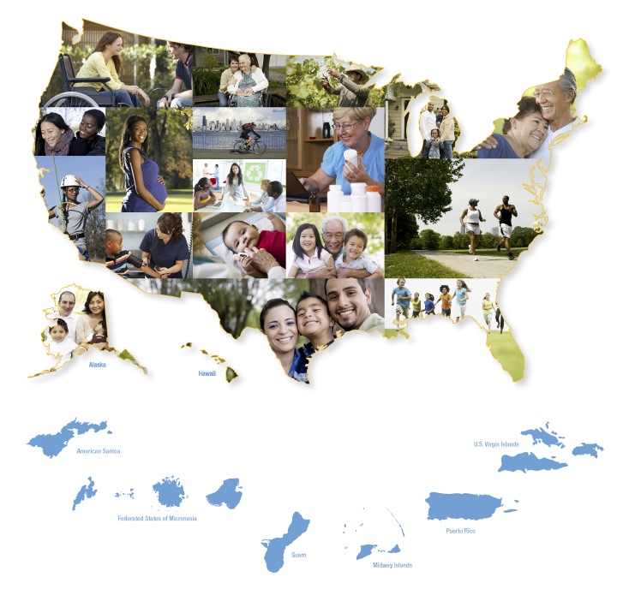
Notes:
We have experience partnering with groups working to build capacity at scale through what we call “mashups,” which is essentially web-based resources for taking action. Content is drawn from different sources, and organized around a shared framework for action.
Our Centre has worked with a variety of partners to create mash-ups on their websites ,ones that fit their frameworks for action and resources they have developed for those with whom they are working.
These partner logos represent a handful of groups we have worked with to make available customized links into relevant resources for their large-scale change efforts.

Slide 36
Implementation supports for change efforts
Notes:
More than 12,000 inbound links to the Tool Box. One example of this: Healthy People 2020. Linking into how-to supports for each phase of their MAP-IT process (e.g., for Mobilizing, Assessing, Planning, etc.)

Slide 37
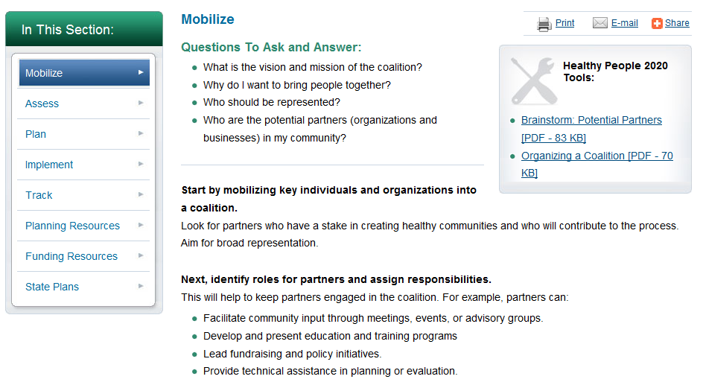

Slide 38
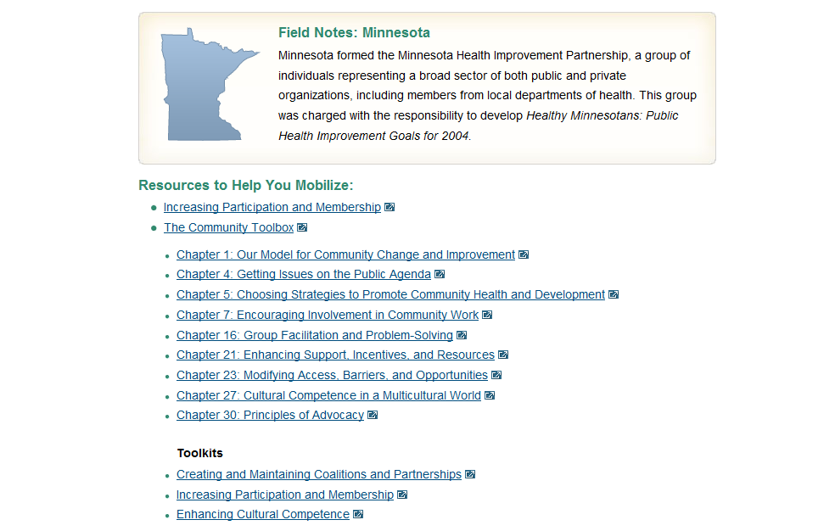

Slide 39
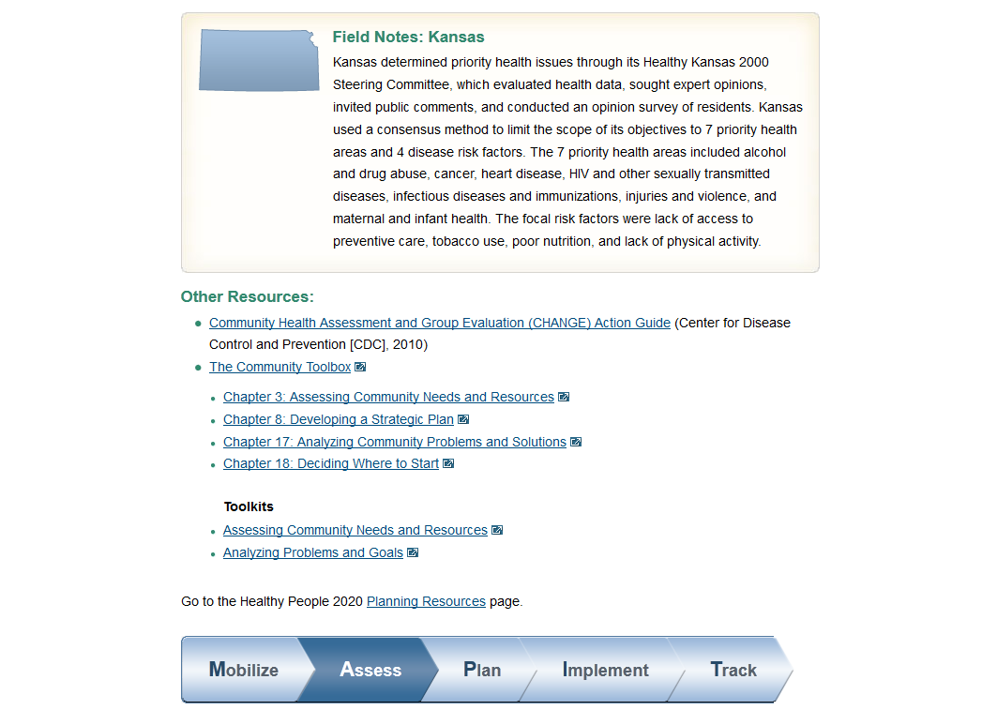

Slide 41
Some opportunities for collaboration
Use of materials to support technical assistance/training
Content mashups
Submission of tools, examples, success stories
Cultural adaptation/translation
Ask an Advisor
Other?

Slide 42
Notes:
Questions? How might you use the Community Tool Box and related online tools to help support your efforts? Do you see opportunities for collaboration?

Slide 43
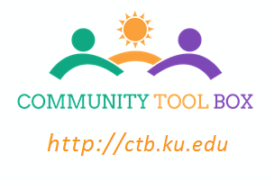
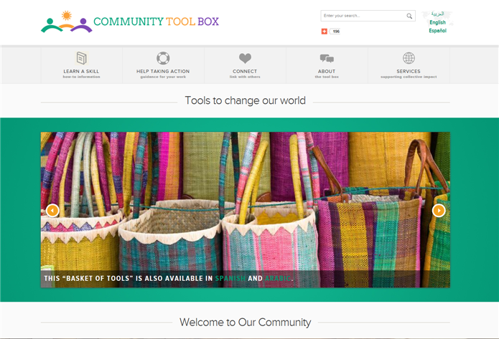
Core Values and Assumptions
Visit the Community Tool Box
Notes:
For more information, please visit the Community Tool Box.

Slide 44
Contact
Christina Holt, cholt@ku.edu
Center for Community Health & Development
University of Kansas
785.864-0533
Visit us: ctb.ku.edu

Slide 45
Douglas County Community Health Plan: 2018 - 2023 Bringing together organizations and community with shared visions & aspirations to engage , draw upon research & best practices and advance solutions to impact health (PSE).
Poverty and Jobs
Behavioral Health
Safe and affordable housing
Food Security & physical activity
Informatics & Analytics
Convener:
L-DCHA
Convener Org: Human Serv. Coalition
CHP
10/18
CH
Assessment
8/17
Convener Org: DC-BHLC
Convener Org: LiveWell
Execution
2019 – 2023
Data Repository & Process Platforms
LDCHD staff w/ 2 Workgroups: Convener & HE
Steering Committee
Health Equity: Fair & Just Opportunity to be Healthier
LDCHealth.org/Healthier Together

Slide 46
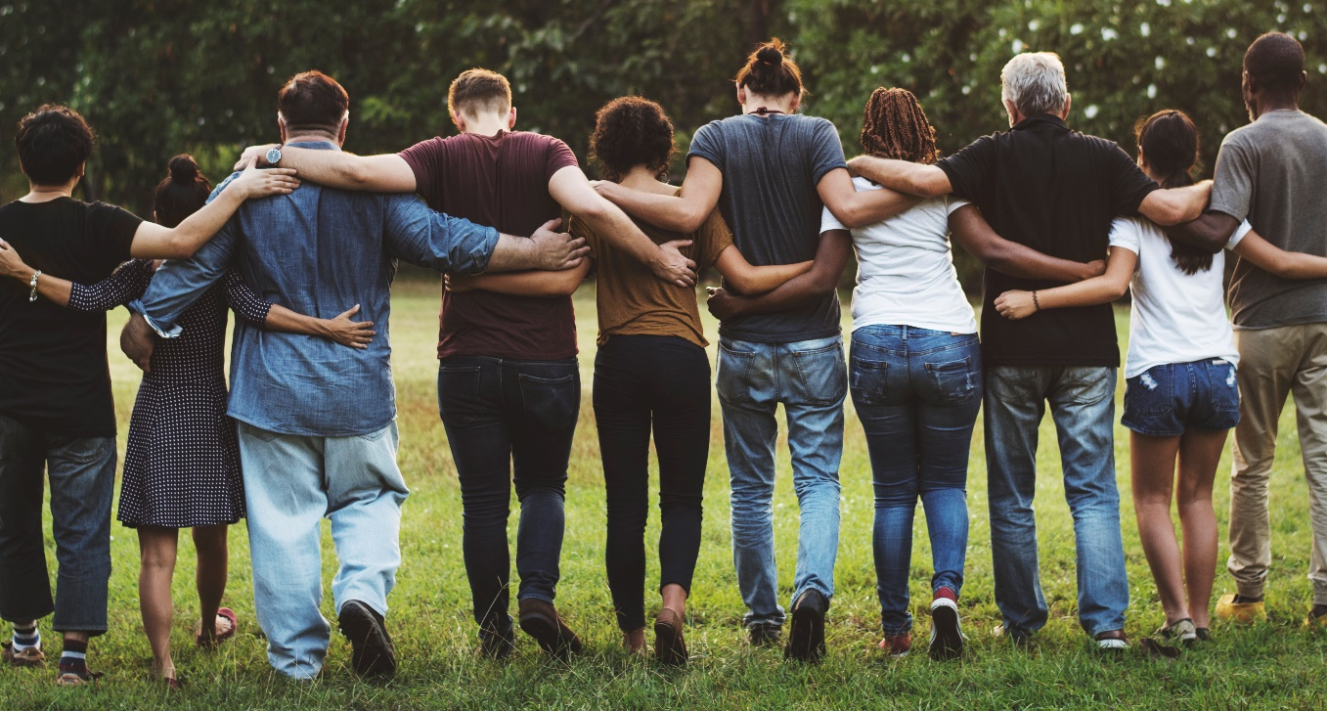
LiveWell Vision and Mission
Our Vision: Communities where we all thrive.
Our Mission: Leading a movement to build communities that support the health and well-being of all.
Notes:
LiveWell envisions Douglas County “communities where we all thrive.”
Our Mission in this work is “Leading a movement to build communities that support the health and well-being of all.”

Slide 47
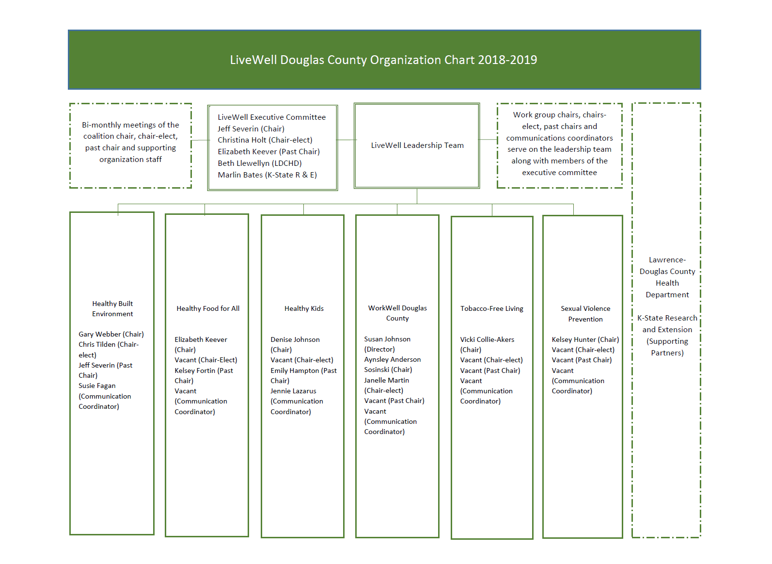
Notes:
LiveWell is proud to be continuing to lead the “Healthy Built Environment” and “Healthy Food for All” areas of the Community Health Plan.
LiveWell work groups include: Healthy Built Environment
Healthy Food for All
Healthy Kids
WorkWell Douglas County
Tobacco-free Living
Sexual Violence Prevention
LiveWell has worked with the Health Department, the Sexual Trauma and Abuse Care Center, and local community residents to form work groups to address tobacco use and sexual violence prevention, which helped our community be competitive for bringing in funds to support efforts in those areas. LiveWell will continue to utilize multi-sectoral partnerships to respond to emergent community opportunities and needs, and leverage funds for our community.
The Sexual Violence Prevention work group has wrapped up an assessment on the risk and protective factors for sexual violence and is planning for improvement.

Slide 48
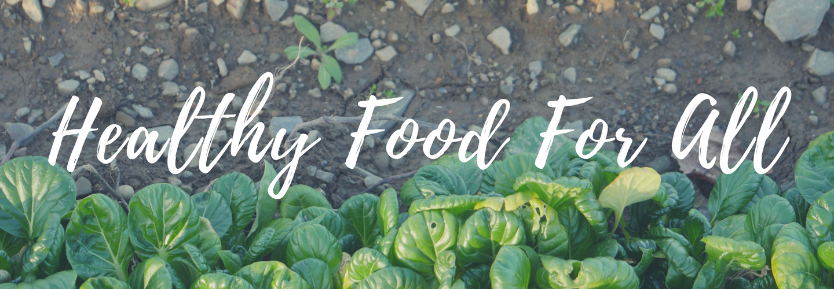
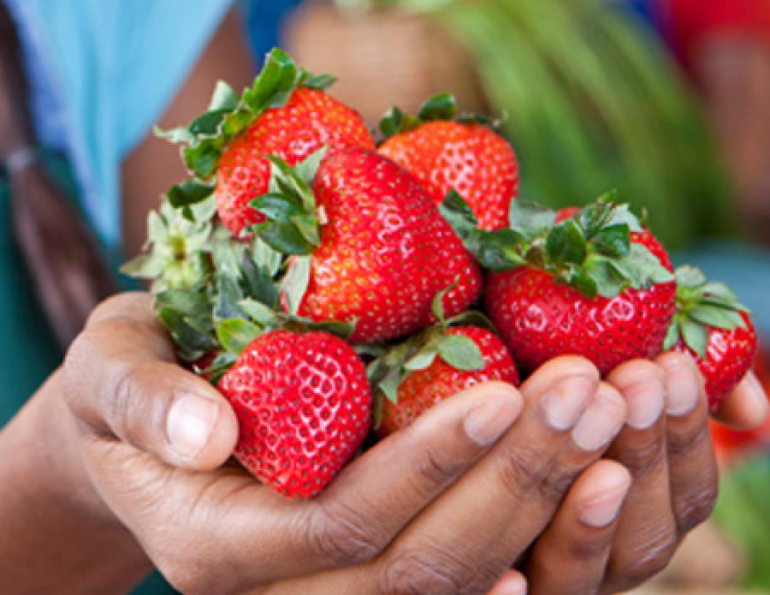
Reducing Food Insecurity
Notes:
LiveWell is working to end hunger in Douglas County (Kelsey serves as Chair of this work group).
Quote from client -
“Many of the people I work with, the only reason they eat is because of places like Just Food, the LINK Kitchen, and Salvation Army. We work with quite a few people who don’ have an income at all, for whatever reason…mental illness, disability, whatever other issues come up that has caused them to be homeless. And so, for a lot of those people, the only places they can go to eat, are places like Just Food, the LINK Kitchen, and Salvation Army. Without Just Food, I have quite a few people that would probably be starving and/ or eating out of a dumpster.”
For these residents of our community, we work to ensure access to food that will fill their bellies and nourish their bodies.
Speaking of the ability to access healthy food from a local pantry, a resident shared, ““It improves your overall quality of life. It really impacts my life. I don’t have to just eat Top Ramen or cans of pork and beans.”
Story upon story from local residents, as well as feedback received from community surveys, led to a number of community-determined strategies for making improvements to reduce food insecurity in our Douglas County communities. These include -
Ensuring enhanced food access for populations facing transportation barriers. We are thrilled to share Just Food has acquired a vehicle to be used as a mobile food pantry, deployed to areas of most critical need.
Growing food recovery practices and policies to increase the supply of safe, nourishing food to those in need
Strengthening the FuelGood Healthy Pantries Initiative to promote adoption of health-promoting policies and practices in food pantries – where our most vulnerable neighbors obtain their sustenance
Removing barriers to and strengthening utilization of public food assistance programs for families with children and seniors, including School breakfast, dinner, and summer meal programs; SNAP; WIC; Double Up Food Bucks; CHAMPPS; Meals on Wheels; and Commodity Supplemental Food Program for seniors
Supporting advocacy efforts
Extending food pantry evening/ weekend availability
And growing “Hunger and Health” efforts to enhance integration of social services and health care (such as diabetes screening and self-management support at local pantries)
While exciting progress is already being made, there is much to do. First, we must continue to “work upstream,” including supporting the Poverty and Jobs work group being convened (first meeting July 10). Become involved in a work group. Lead a healthy food drive. Support policies that support a living wage. Raise awareness in your circles of influence. Serve as a founding partner to help establish funds to hire an executive director so critical to moving this work forward.

Slide 49
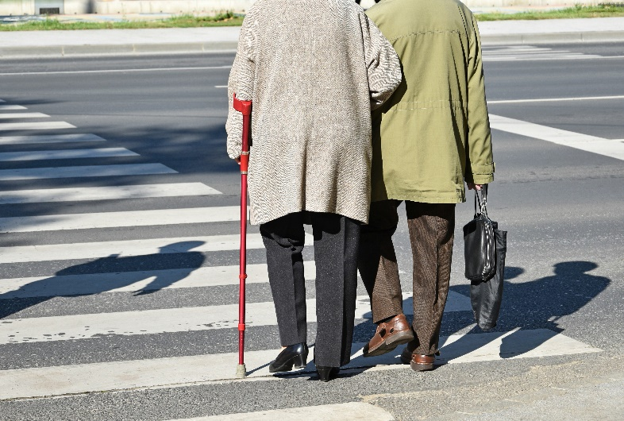
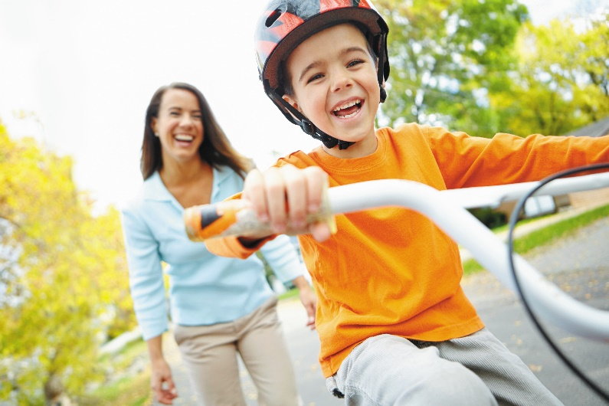
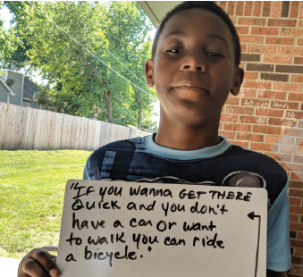
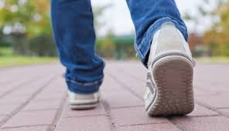
Healthy Built Environment
Notes:
Strategies for making improvements to our built environment include:
Working with local cities to advance a safe and robust pedestrian and bicycle network
The Metropolitan Planning Organization (MPO) is in the process of finalizing an update to the Douglas Countywide Bikeway Plan. Specifically, a section called “Lawrence Bikes” is focusing on the bikeway network in Lawrence will be integrated into the existing bikeway plan. Public comment is being accepted through tomorrow (June 14).
In February the city of Lawrence received a $480,000 Kansas Department of Transportation (KDOT) “Transportation Alternatives” grant to extend the Lawrence Loop from its current terminus in east Lawrence at 11th Street to approximately 7th Street. KDOT requires a 20% local match, and it is anticipated the city will approve this match as part of the 2020 budget process. A timeline for construction has not been provided to the public at this time.
Working with school districts and municipalities to assure completion, adoption, and implementation of regional or school district Safe Routes to School Plans
The MPO is also launching an effort to create a regional Safe Routes to School Plan. There is little detail available yet on the timing and process for the development of the plan, but it will likely start soon, as MPO staff have indicated this in recent public forums.
Supporting school districts’ efforts to adopt evidence-based policies that support opportunities for youth to be physically active
Supporting ongoing development of public transit, with access for people of all abilities
Promoting community initiatives that support well maintained, equitably funded sidewalk networks.
The sidewalk maintenance debate is heating up a bit, and there are sidewalk improvements being made in the northwest quadrant of the city where the sidewalk maintenance program has been initially implemented.
And increasing the number of workplaces that are actively engaged with Healthy Eating Active Living (HEAL) initiatives

Slide 50
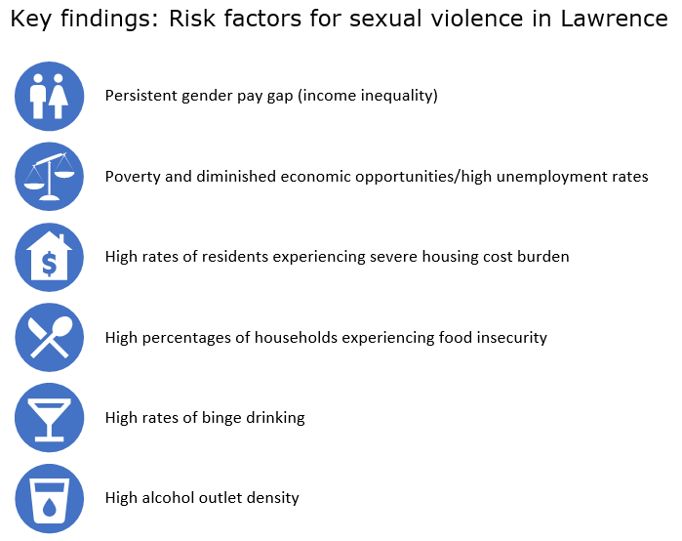
Notes:
Here you can see the key findings related to risk factors for Sexual Violence in Lawrence – and overlap with many of the issues in the community health plan:
Income inequality
Poverty
Housing
Food insecurity
Binge drinking/ high alcohol outlet density
I hope that there will be opportunities for collaboration going forward as efforts move upstream to affect social determinants.

Slide 51
Community health improvement plan
Poverty and jobs
Behavioral health
Safe and affordable housing
Access to healthy food and physical activity
Equity & Discrimination
Notes:
LiveWell continues to lead efforts to address food security and a healthy built environment laid out in our new 5-year community health improvement plan, starting with those in greatest need.
[Open it up for questions]

